Slide 1
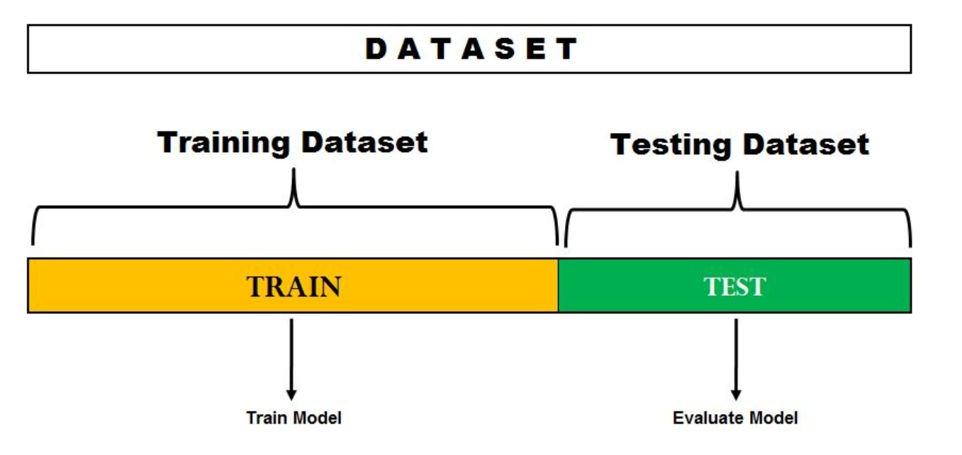
Model Validation

Slide 2
Model Validation
Model validation is the process of evaluating how well a machine learning model generalizes to unseen data, rather than how well it performs on the data it was trained on
Will this model work well on new, real-world data?”
The model validation methods use test data to validate the model built using train data
Model validation techniques:
  k - fold cross validation
  Leave one out cross validation (LOOCV)

Slide 3
Model validation
Cross-Validation
Whenever we build any machine learning model, we feed it with initial data to train the model. And then we feed some unknown data (test data) to understand how well the model performs and generalized over unseen data.
If the model performs well on the unseen data, it’s consistent and is able to predict with good accuracy on a wide range of input data; then this model is stable.
But this is not the case always!
Machine learning models are not always stable and we have to evaluate the stability of the machine learning model. That is where Cross Validation comes into the picture.

Slide 4
Model Validation
suppose we build a machine learning model to solve a problem, and we have trained the model on a given dataset. When we check the accuracy of the model on the training data, it is close to 95%. Does this mean that our model has trained very well, and it is the best model because of the high accuracy?
No, it’s not! Because our model is trained on the given data, it knows the data well, captured even the minute variations(noise), and has generalized very well over the given data. If we expose the model to completely new, unseen data, it might not predict with the same accuracy and it might fail to generalize over the new data. This problem is called over-fitting.
Sometimes the model doesn’t train well on the training set as it’s not able to find patterns. In this case, it wouldn’t perform well on the test set as well. This problem is called Under-fitting.
To overcome over-fitting problems, we use a technique called Cross-Validation.

Slide 5
Cross-validation
Cross-validation is a resampling procedure used to evaluate machine learning models on a limited data sample.
It works by:
Splitting the dataset into several parts.
Training the model on some parts and testing it on the remaining part.
Repeating this resampling process multiple times by choosing different parts of the dataset.
Averaging the results from each validation step to get the final performance.

Slide 6
Types of Cross-Validation
There are several types of cross-validation techniques which are as follows:
1. Holdout Validation
In Holdout Validation method typically 50% data is used for training and 50% for testing. Making it simple and quick to apply. The major drawback of this method is that only 50% data is used for training, the model may miss important patterns in the other half which leads to high bias.

Slide 7
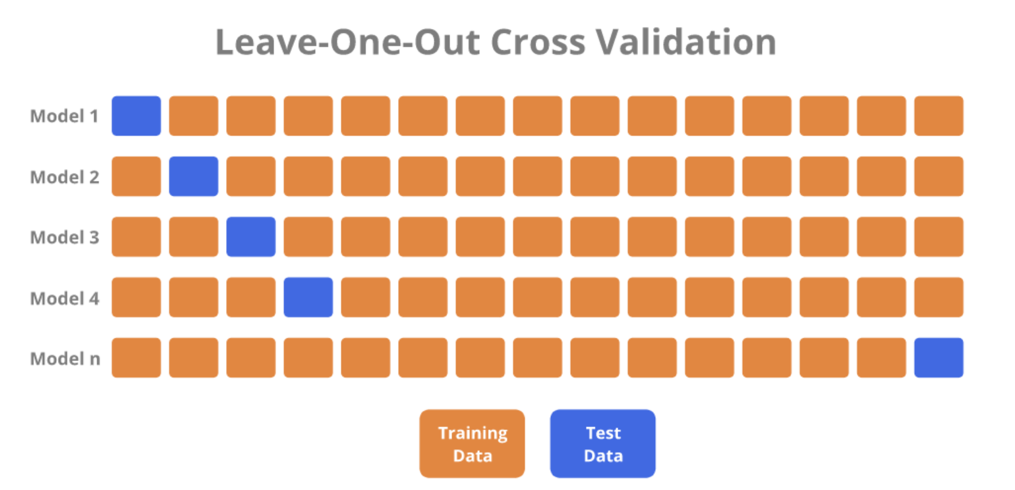
2. LOOCV (Leave One Out Cross Validation)
In this method the model is trained on the entire dataset except for one data point which is used for testing. This process is repeated for each data point in the dataset.
All data points are used for training, resulting in low bias.
Testing on a single data point can cause high variance, especially if the point is an outlier.
It can be very time-consuming for large datasets as it requires one iteration per data point.

Slide 8
Leave-One-Out Cross-Validation
It is a special case of k - fold cross validation method. Instead of subsetting the data, at every run one observation is considered as the test set
In each iteration, n-1 observations are used for training, and the remaining observation is used for testing.
For n observations, there are n runs
The total error is the sum of errors for n runs
In LOOCV, the estimates from each fold are highly correlated and their average can have a high level of variance
LOOCV is particularly useful for small datasets, where every data point is valuable for testing. However, due to its computational intensity and the potential for high variance in estimates, it may not always be the best choice for larger datasets.

Slide 9
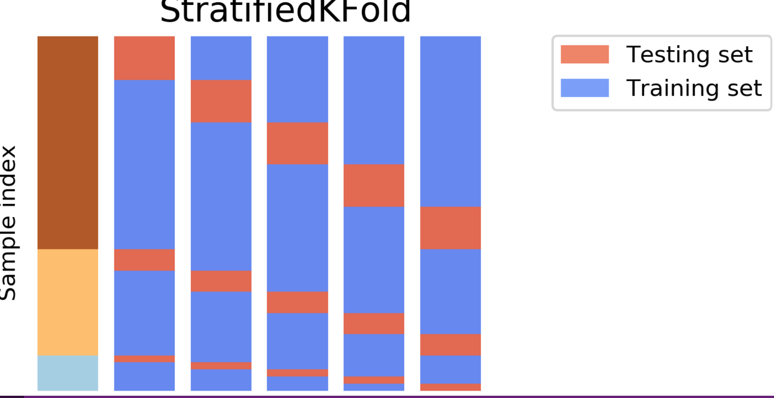
Types of Cross-Validation
3. Stratified Cross-Validation
It is a technique that ensures each fold of the cross-validation process has the same class distribution as the full dataset.
This is useful for imbalanced datasets where some classes are underrepresented.
The dataset is divided into k folds, keeping class proportions consistent in each fold.
In each iteration, one fold is used for testing and the remaining folds for training.
This process is repeated k times so that each fold is used once as the test set.
It helps classification models generalize better by maintaining balanced class representation.

Slide 10
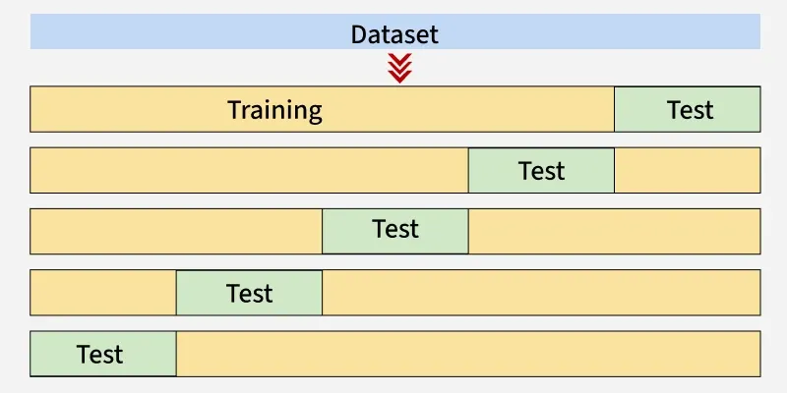
K - Fold Cross Validation
4. K-Fold Cross Validation
K-Fold Cross Validation splits the dataset into k equal-sized folds. The model is trained on k-1 folds and tested on the remaining fold. This process is repeated k times each time using a different fold for testing.
Procedure:
  Partition the dataset into ‘k’ subsets
  Consider one subset as the test set and remaining subsets as train set
  Measure the model performance
  Repeat this until all k subsets are considered as test set
  The overall performance metric (such as accuracy, error rate, etc.) is obtained by averaging the performance metrics from all k runs.
This method is known as the k - fold cross validation
Here, each observation is used exactly k times for training and exactly once for testing

Slide 11
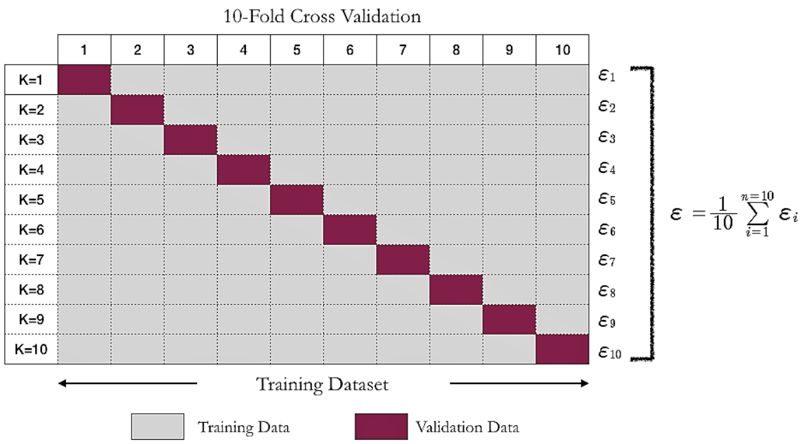
10 - Fold Cross Validation
The split of training and test for each run.
And the total error is given by:

Slide 12
Grid Search
GridSearchCV: A hyperparameter tuning method that exhaustively searches parameter
combinations using cross-validation.
RandomizedSearchCV: A faster alternative that randomly samples hyperparameter combinations.

Slide 13
Grid Search
The grid search is the process of tuning the hyperparameters to obtain the optimum values of the hyperparameters.
Just as the name suggests, a grid of performance measure is obtained
Wherein each measure corresponds to a given hyperparameter values
Obtain the corresponding hyperparameters whose performance measure is highest

Slide 14
Grid Search
Procedure:
Define the Hyperparameter Grid: Create a grid of hyperparameter values to explore. Each combination of hyperparameters forms a unique configuration for the model.
Perform Cross-Validation: For each combination in the grid, the model is trained and validated using cross-validation. This means the dataset is partitioned into multiple subsets to ensure that the model's performance is evaluated on different portions of the data.
Evaluate Performance: Calculate performance metrics (like accuracy, F1 score, etc.) for each configuration based on the results of cross-validation.
Select the Best Hyperparameters: Identify the hyperparameter combination that yields the highest performance metric. This combination will be used to fit the final model.

Slide 15
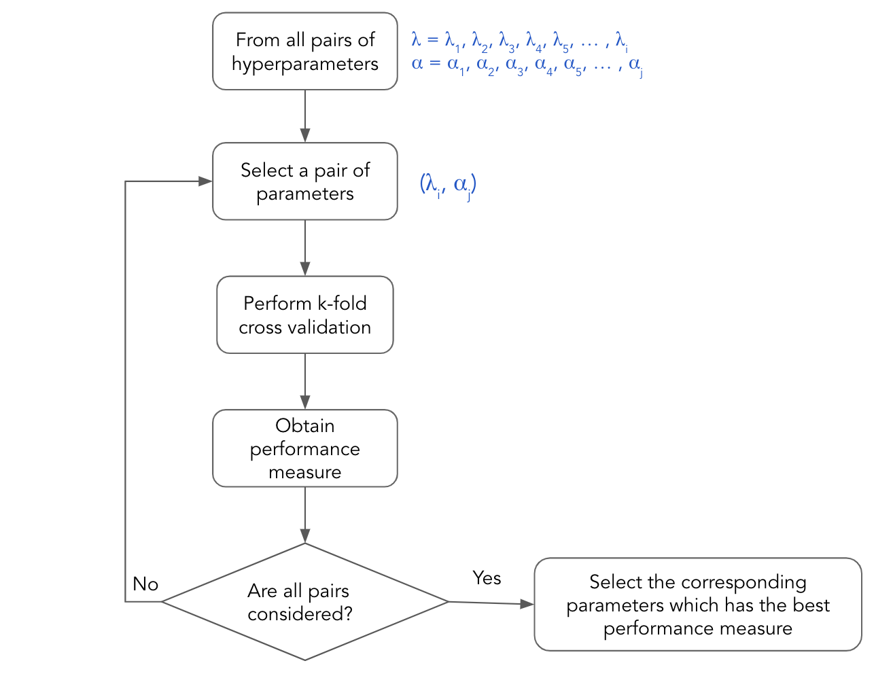
Grid Search
param_grid = {
'n_estimators': [100, 200],
'max_depth': [5, 10],
'min_samples_split': [2, 5]
}
grid = GridSearchCV(
estimator=model,
param_grid=param_grid,
cv=5,
scoring='roc_auc',
n_jobs=-1
)

Slide 16
Grid Search
Advantages
Exhaustive Search: It systematically explores all possible combinations of hyperparameters, ensuring the optimal set is found within the specified grid.
Robust Performance Evaluation: By using cross-validation, it provides a reliable estimate of model performance, reducing the risk of overfitting to the training set.
Simplicity: The process is straightforward and easy to implement.

Slide 17
Grid Search
Disadvantages
Computationally Expensive: As the number of hyperparameters and their respective values increases, the computational cost grows exponentially, making it inefficient for large grids.
Limited Flexibility: It only evaluates predefined combinations of hyperparameters and may miss the optimal set that lies outside the grid.
Time-Consuming: Due to the exhaustive nature of the search, it can take a considerable amount of time to complete, especially with large datasets or complex models.

Slide 18
Randomized Search CV
Randomized Search CV is another hyperparameter tuning technique that samples a fixed number of hyperparameter combinations from a specified distribution instead of exhaustively searching through all combinations. This approach is useful when dealing with a large hyperparameter space.
Key Features:
Sampling Strategy: Instead of evaluating all possible combinations, it randomly samples a specified number of parameter settings, making it faster than grid search.
Speed: By limiting the number of iterations, it can significantly reduce the computational time needed for hyperparameter tuning, especially in large datasets or complex models.

Slide 19
Randomized Search CV
Procedure:
Define Hyperparameter Distributions: Specify the ranges or distributions for each hyperparameter you want to tune. For example:
  For the maximum depth of Decision Tree, you could use values like [5, 10, 15].
Set Number of Iterations: Determine how many random combinations of hyperparameters to evaluate.
Randomly Sample Combinations: Sample combinations from the defined distributions and evaluate model performance using cross-validation.
Select Best Hyperparameters: After evaluating the specified number of combinations, select the hyperparameters that yield the best performance based on your chosen evaluation metrics.
param_dist = {
'n_estimators': randint(50, 300),
'max_depth': randint(3, 20),
'min_samples_split': randint(2, 10)
}
random_search = RandomizedSearchCV(
estimator=model,
param_distributions=param_dist,
n_iter=20,
cv=5,
scoring='roc_auc',
random_state=42,
n_jobs=-1
)

Slide 20
Randomized Search CV
Advantages:
Efficiency: Can find good hyperparameter settings faster than grid search, especially in high-dimensional spaces.
Exploration of Hyperparameter Space: Allows for a more diverse exploration of hyperparameters by sampling from distributions.
Less Prone to Overfitting: By evaluating fewer combinations, it reduces the risk of overfitting to the validation set.
Disadvantages:
Stochastic Nature: Results can vary between runs since it relies on random sampling, which might lead to inconsistencies in performance evaluation.
May Miss Optimal Parameters: There is a chance of not finding the absolute best parameter settings because it doesn’t evaluate all combinations.
The effectiveness depends on how well the user defines the distributions for the hyperparameters.

Slide 21
Comparison
Feature | Grid Search CV | Randomized Search CV
Search Method | Exhaustive search over specified parameter values. | Random search over specified parameter distributions.
Parameter Combinations | Evaluates all combinations of parameters. | Evaluates a fixed number of random combinations.
Time Complexity | High; can be computationally expensive. | Lower; faster as it samples a subset of combinations.
Optimality | Finds the optimal parameters among all options. | May not find the absolute best parameters, but good enough.
Control Over Evaluation | No control over the number of combinations evaluated. | Control over the number of iterations.
Use Case | Best when the parameter space is small. | Suitable for large parameter spaces or when computation time is a concern.

Slide 22
Key difference: How parameters are explored
🔹 GridSearchCV
Tries ALL possible combinations
Exhaustive and deterministic
If you had:
max_depth = 2 values n_estimators = 190 values max_features = 10 values min_samples_split = 9 values min_samples_leaf = 10
values bootstrap = 2 values criterion = 2 values
Total combinations:
2 × 190 × 10 × 9 × 10 × 2 × 2 = 136,800 models
RandomizedSearchCV
Randomly samples parameter combinations
Does NOT try all combinations
Much faster for large search spaces
By default:
RandomizedSearchCV(..., n_iter=10)
👉 Only 10 random combinations are tried (not 136,800)
This means:
sklearn will randomly pick combinations from param_dist
Each iteration samples:
  one random max_depth
  one random n_estimators
  one random max_features, etc.
It evaluates only n_iter such combinations using CV

Slide 23
Key factors that determine the optimal k
Dataset size
  Small datasets → use larger k (e.g., 10 or even Leave-One-Out) to reduce bias.
  Large datasets → smaller k (e.g., 5) is sufficient and faster.
Bias–variance trade-off
  Small k (e.g., 3–5)
    Higher bias, lower variance
    Faster computation
  Large k (e.g., 10–LOOCV)
    Lower bias, higher variance
    More computationally expensive
Model complexity
  Complex / high-variance models (e.g., decision trees, neural nets)
  → Prefer k = 5 or 10 to avoid unstable estimates.
  Simple models (e.g., linear regression)
  → Larger k is acceptable.
Computational cost
  Training time grows linearly with k.
  If model training is expensive, use k = 5.
Class imbalance (classification problems)
  Use Stratified k-fold so each fold preserves class proportions.
  k must be large enough to keep minority classes represented in each fold.
Data variability / noise
  Noisy data benefits from moderate k (5–10) to avoid overfitting to small validation sets.

Slide 24
Common best practices
k = 5 or 10 → Industry standard, good balance of bias, variance, and cost.
k = 10 → Preferred for academic benchmarks.
k = n (LOOCV) → Only when data is very small and model is fast.
Rule of thumb
If unsure, start with k = 5, and compare results with k = 10.

Slide 25
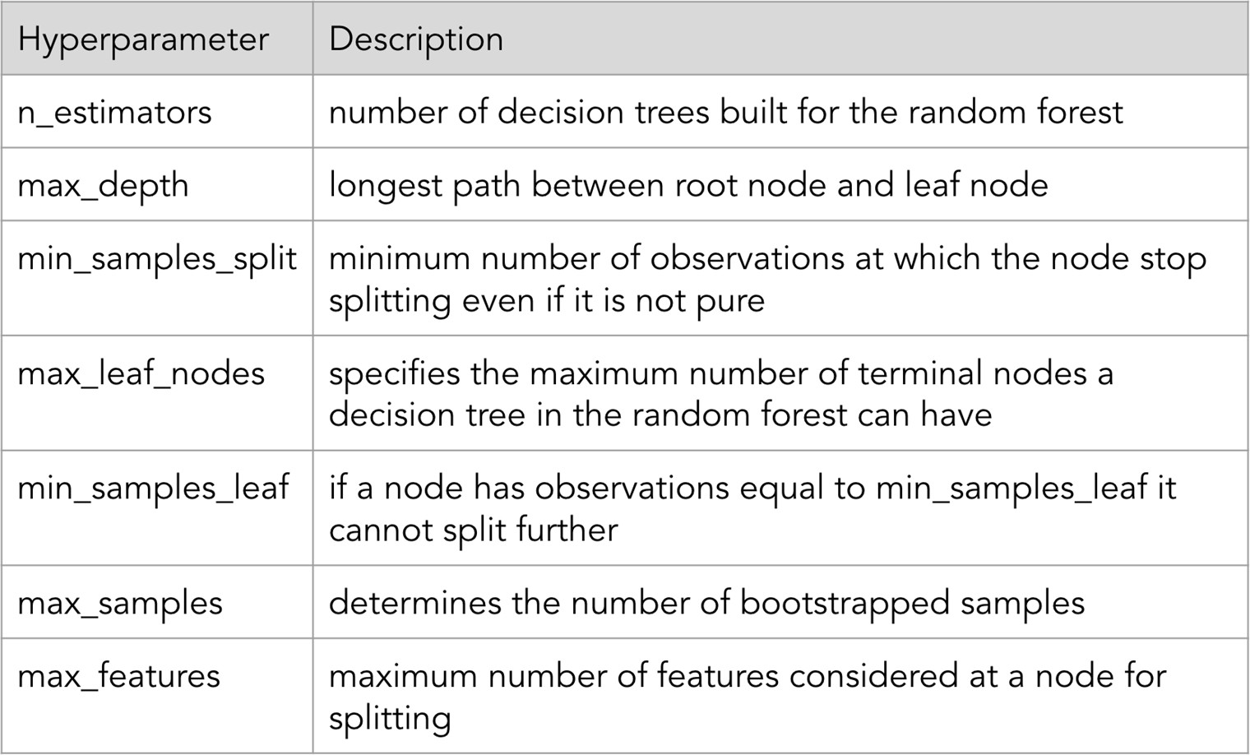
Random forest hyperparameters

Slide 26
1. What is the primary purpose of model evaluation in machine learning?
A. To increase the size of the training dataset
B. To measure how well a model fits the training data
C. To assess how well a model generalizes to unseen data
D. To reduce computational cost
2. In K-Fold Cross-Validation, increasing the value of K generally results in:
A. Higher bias and higher variance
B. Lower bias but higher variance and computation
C. Lower variance but higher bias
D. No change in bias or variance

Slide 27
3. Which of the following is a key advantage of K-Fold Cross-Validation over a simple train-test split?
It completely removes overfitting
B. It uses less data for training
C. It provides a more reliable estimate of model performance
D. It requires no computational overhead
4. What is the main objective of GridSearchCV?
To select the best features
B. To train multiple models simultaneously
C. To find the optimal hyperparameter combination using exhaustive search
D. To reduce training data size
5. Compared to GridSearchCV, RandomizedSearchCV:
A. Tries all possible hyperparameter combinations
B. Is always less accurate
C. Samples a fixed number of random hyperparameter combinations
D. Cannot be used with cross-validation

